Slide 1
Safe Lane Changes
By: Khush Lalchandani

Slide 2
Abstract
This presentation covers three studies on advanced traffic management systems. The first study introduces an anticipatory lane change warning system using V2V communications to improve traffic safety. The second study optimizes lane-changing trajectories in a CAV(Connected Automated Vehicles) environment to minimize traffic flow disturbances. The third study tries to reduce lane changing conflicts using probability collectives.

Slide 3
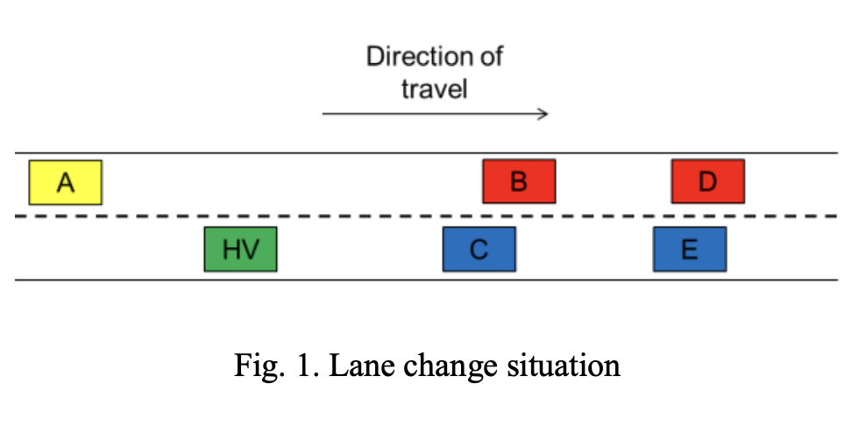
Paper 1: Anticipatory Lane Change Warning using Vehicle-to-Vehicle Communications
Develop an algorithm to predict unsafe lane changes.
Utilize V2V communication to overcome the limitations of on-board sensors

Slide 4
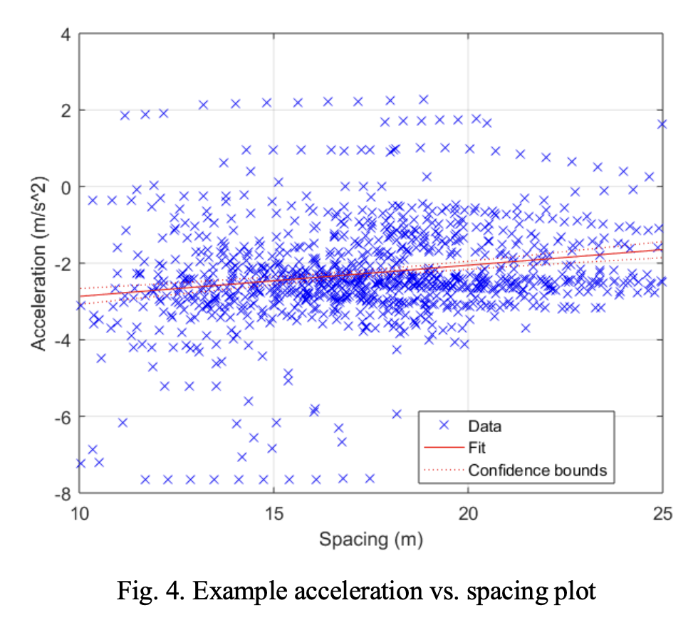
Methodology
Position and acceleration are modelled using speed measurements
Model predicts deceleration needed
Cars are allowed to change lanes if 2-3 seconds of headway is given

Slide 5
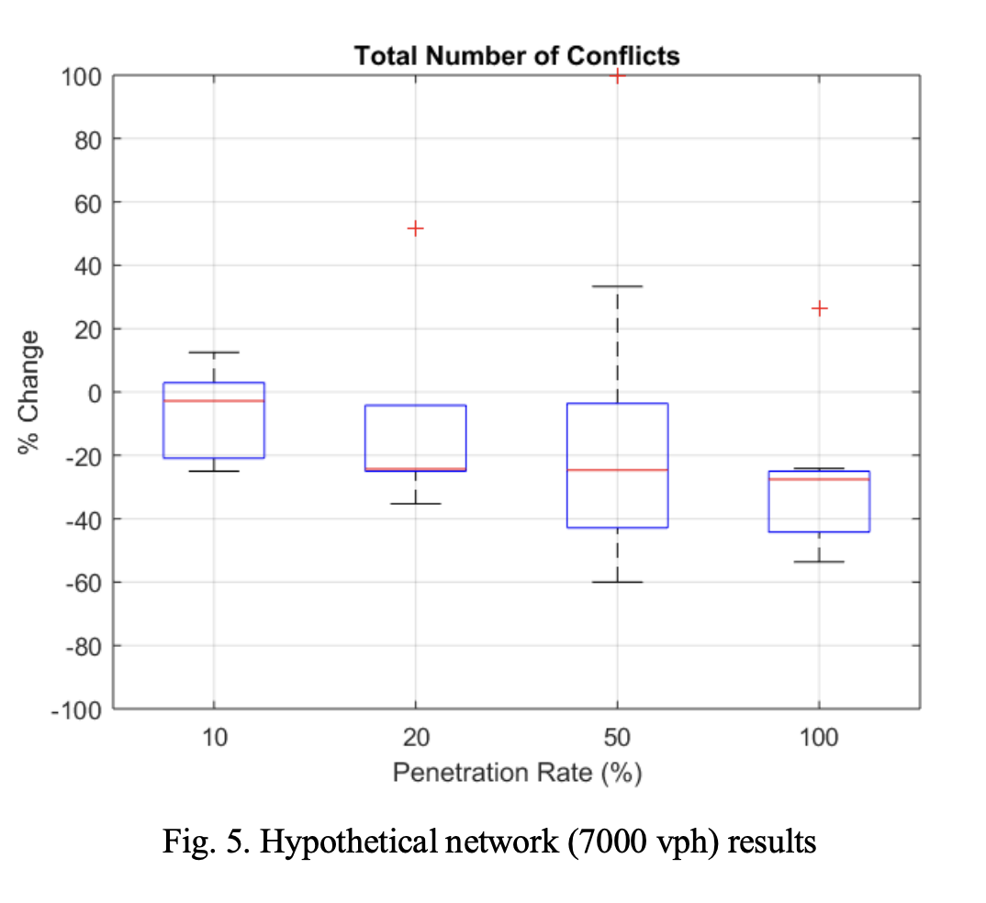
Methodology
DSRC (Dedicated Short Range Communication) helps vehicles communicate
Penetration rate represents how many cars are equipped with V2V technology
Tested in VISSIM traffic simulator and then in real life

Slide 6
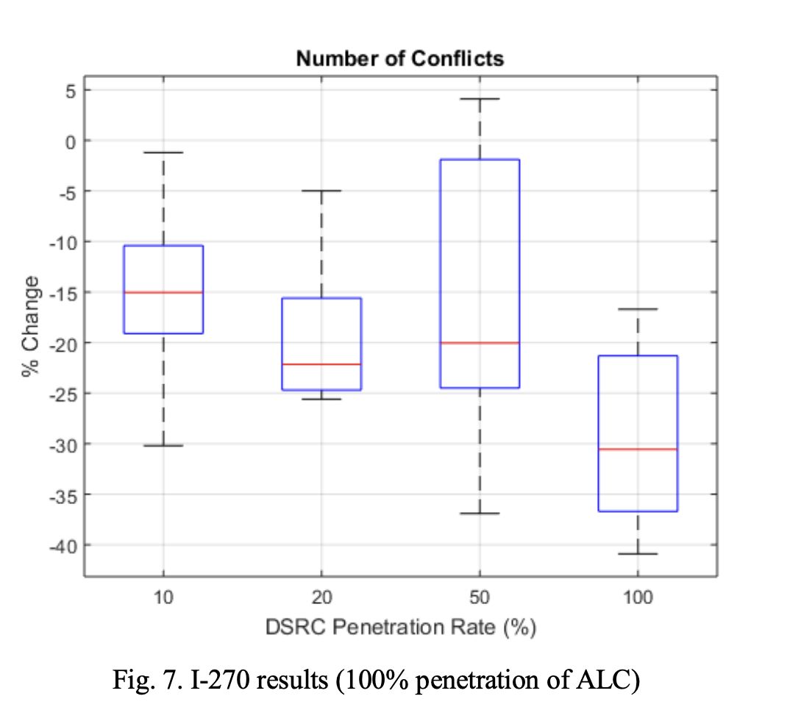
Results and Findings
Reduced potential traffic conflicts by up to 30%
Minimal impact on average speed and overall mobility
Higher benefits observed in congested conditions

Slide 7
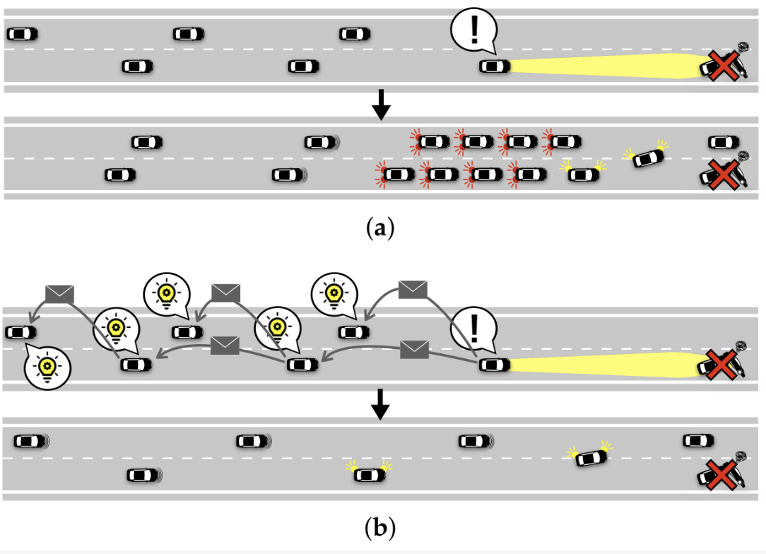
Safe, Smooth, and Fair Rule-Based Cooperative Lane Change Control for Sudden Obstacle Avoidance on a Multi-Lane Road
Avoid obstacles on a multi lane road using a V2V system
Goal is to maintain safety and ride comfort

Slide 8
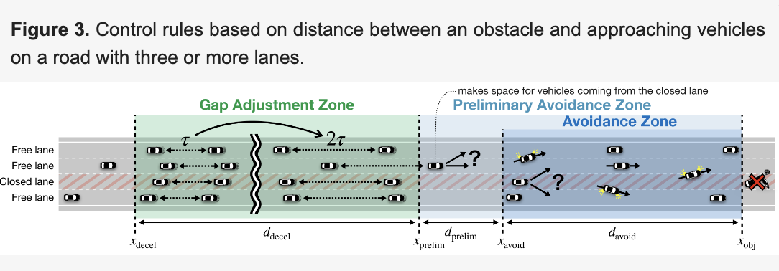
Methodology
Connected Vehicle detects obstacle on road
Notifies vehicles in a larger radius to take action
MPC for vehicle in target lane to respond to lane changes
Number of cars in lane is balanced and cars travel below max comfort acceleration

Slide 9
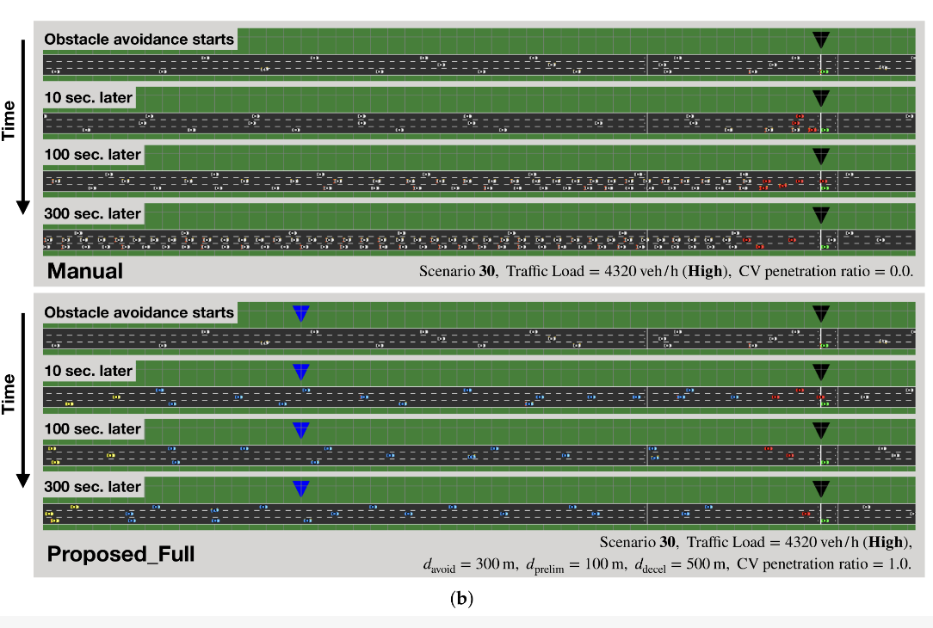
Results and Findings
Minimized acceleration disturbances and shockwaves
Maintained passenger comfort during maneuvers

Slide 10
Paper 3: Automated Conflict Resolution of Lane Change Utilizing Probability Collectives
Objective:Create a Probability Collectives approach to resolve the conflict resolution of lane change maneuvers in highway scenarios to avoid collisions
Probability Collectives (PC) is used for sampling joint probability distributions over the actions of multiple agents. Each agent has a probability distribution over its actions and chooses its actions independently by sampling from this distribution. The goal of PC is to find a joint action that resolves conflicts among all agents with the lowest cost.

Slide 11
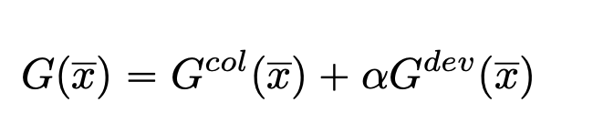
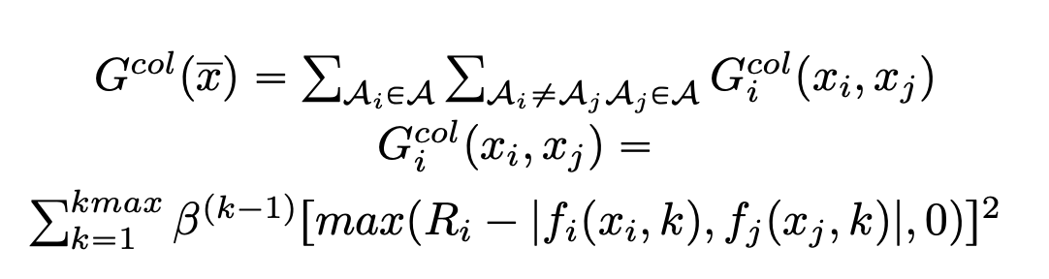
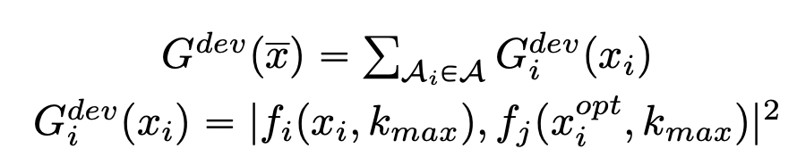
Methodology
Identifies conflicts based on Euclidean distance with a safe threshold.
Developed a global cost function combining collision avoidance and trajectory adherence
Applied Probability Collectives to iteratively adjust each vehicle's action probability distribution

Slide 12
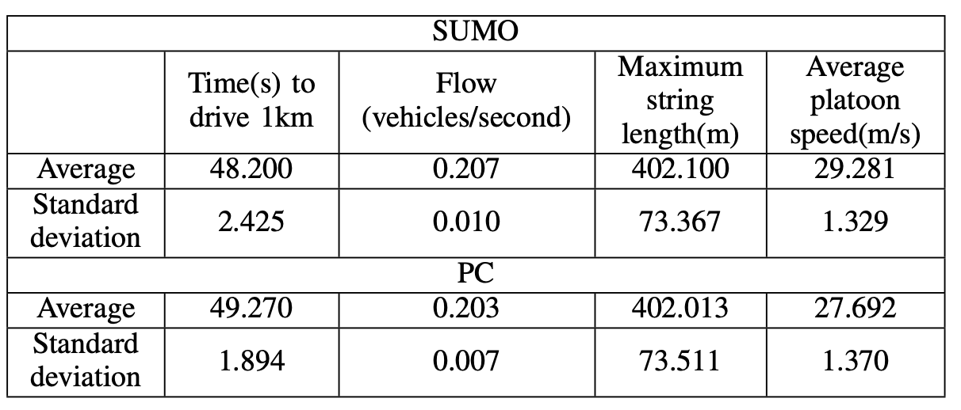
Results and Findings
Simulated scenarios in SUMO to compare the decentralized Probability Collectives approach with a centralized lane change method
Focus was on the vehicle flow and average platoon speed

Slide 13
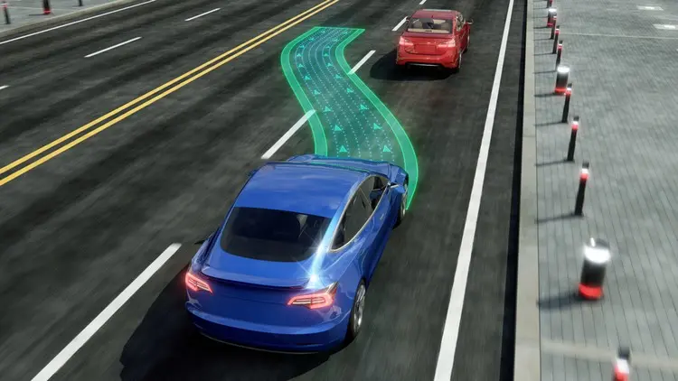
Conclusion and Future Research
Future Research:
Real-world data validation and long-term impacts of these technologies
Combination of these ideas with adaptive cruise control and lane departure warning systems

Slide 14
References
N. Williams, G. Wu, K. Boriboonsomsin, M. Barth, S. Rajab and S. Bai, "Anticipatory Lane Change Warning using Vehicle-to-Vehicle Communications," 2018 21st International Conference on Intelligent Transportation Systems (ITSC), Maui, HI, USA, 2018, pp. 117-122, doi: 10.1109/ITSC.2018.8569910. keywords: {Prediction algorithms;Radar;Safety;Sensors;Predictive models;Distance measurement;Traffic control;V2X;lane change;automated vehicles;connected vehicles;ADAS},
Asano S, Ishihara S. Safe, Smooth, and Fair Rule-Based Cooperative Lane Change Control for Sudden Obstacle Avoidance on a Multi-Lane Road. Applied Sciences. 2022; 12(17):8528. https://doi.org/10.3390/app12178528
T. C. dos Santos and D. F. Wolf, "Automated Conflict Resolution of Lane Change Utilizing Probability Collectives," 2019 19th International Conference on Advanced Robotics (ICAR), Belo Horizonte, Brazil, 2019, pp. 623-628, doi: 10.1109/ICAR46387.2019.8981609. keywords: {Probability Collectives;lane change;lane merge;connected vehicles;v2v},

